Slide 1
Sentimental Analysis - #MeToo Movement
Team
Ridhima Shinde
Ankit Shah
Dhananjay Shinkar
Harshit Shah
Parag Soni
Web Mining Project

Slide 2
Contents
Introduction
Sentimental Analysis
Problem Statement
Bar Plot
Word Cloud
Data Processing & Cleaning Technique
Code Explanation
Summary

Slide 3
Introduction
The Me Too movement or #MeToo movement, is a movement against sexual harassment and sexual assault, especially in the workplace, through the shared posts on social media platforms with the hashtag #MeToo.
Sexual abuse – a highly stigmatized topic in the society has spurred a revolution in the recent years.
Individuals from different backgrounds and ethnicities began sharing on the online venues about their personal experiences of getting sexually assaulted.

Slide 4
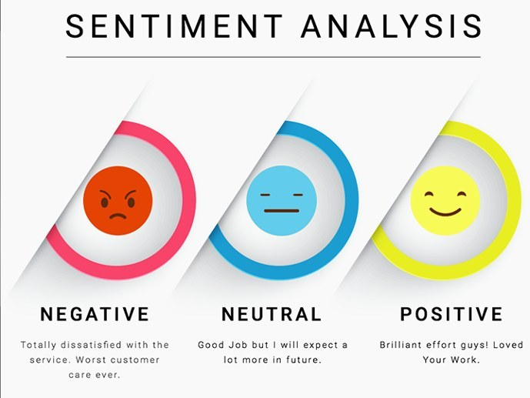
Sentimental Analysis
Sentiment Analysis is the process of determining whether a piece of writing is positive, negative or neutral.
It's also known as opinion mining, deriving the opinion or attitude of a speaker.
A common use case for this technology is to discover how people feel about a particular topic.

Slide 5
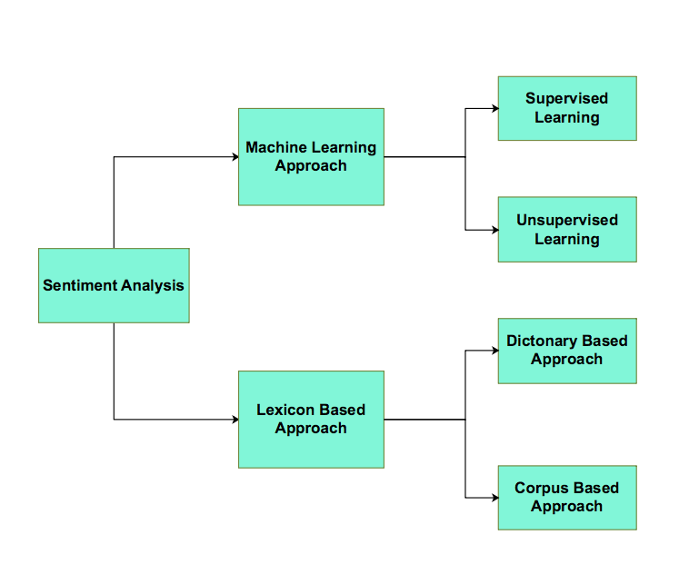
Sentimental
Analysis

Slide 6

Analyze what aspects of given tweets led to their remarkable level of engagement.
Input to our algorithms was the number of word occurrences in the content of a given tweet.
Providing insights into the potential reach and also understanding what content is likely to reach towards the globe.
Problem Statement

Slide 7
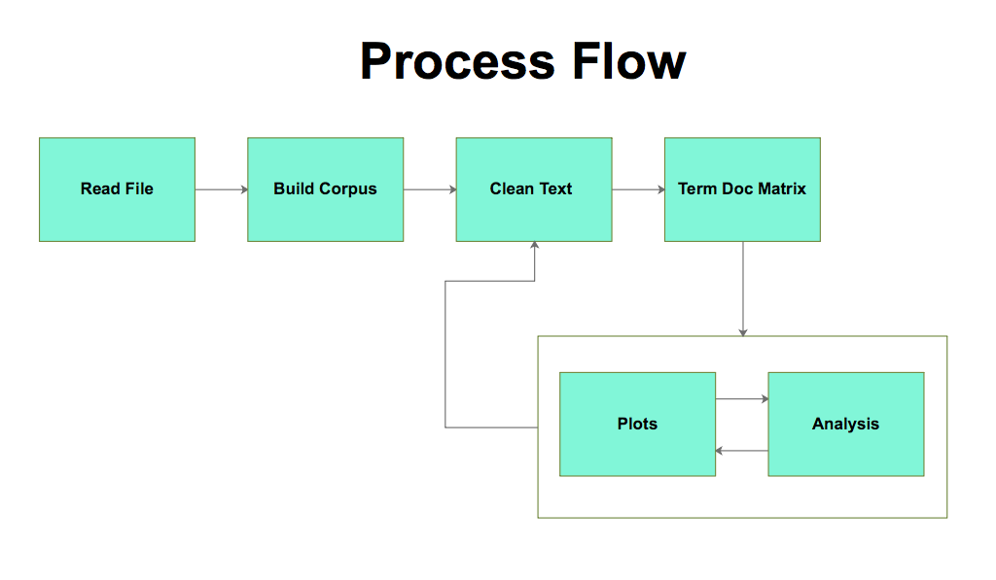

Slide 8
Word Cloud & Bar Plots

Slide 9
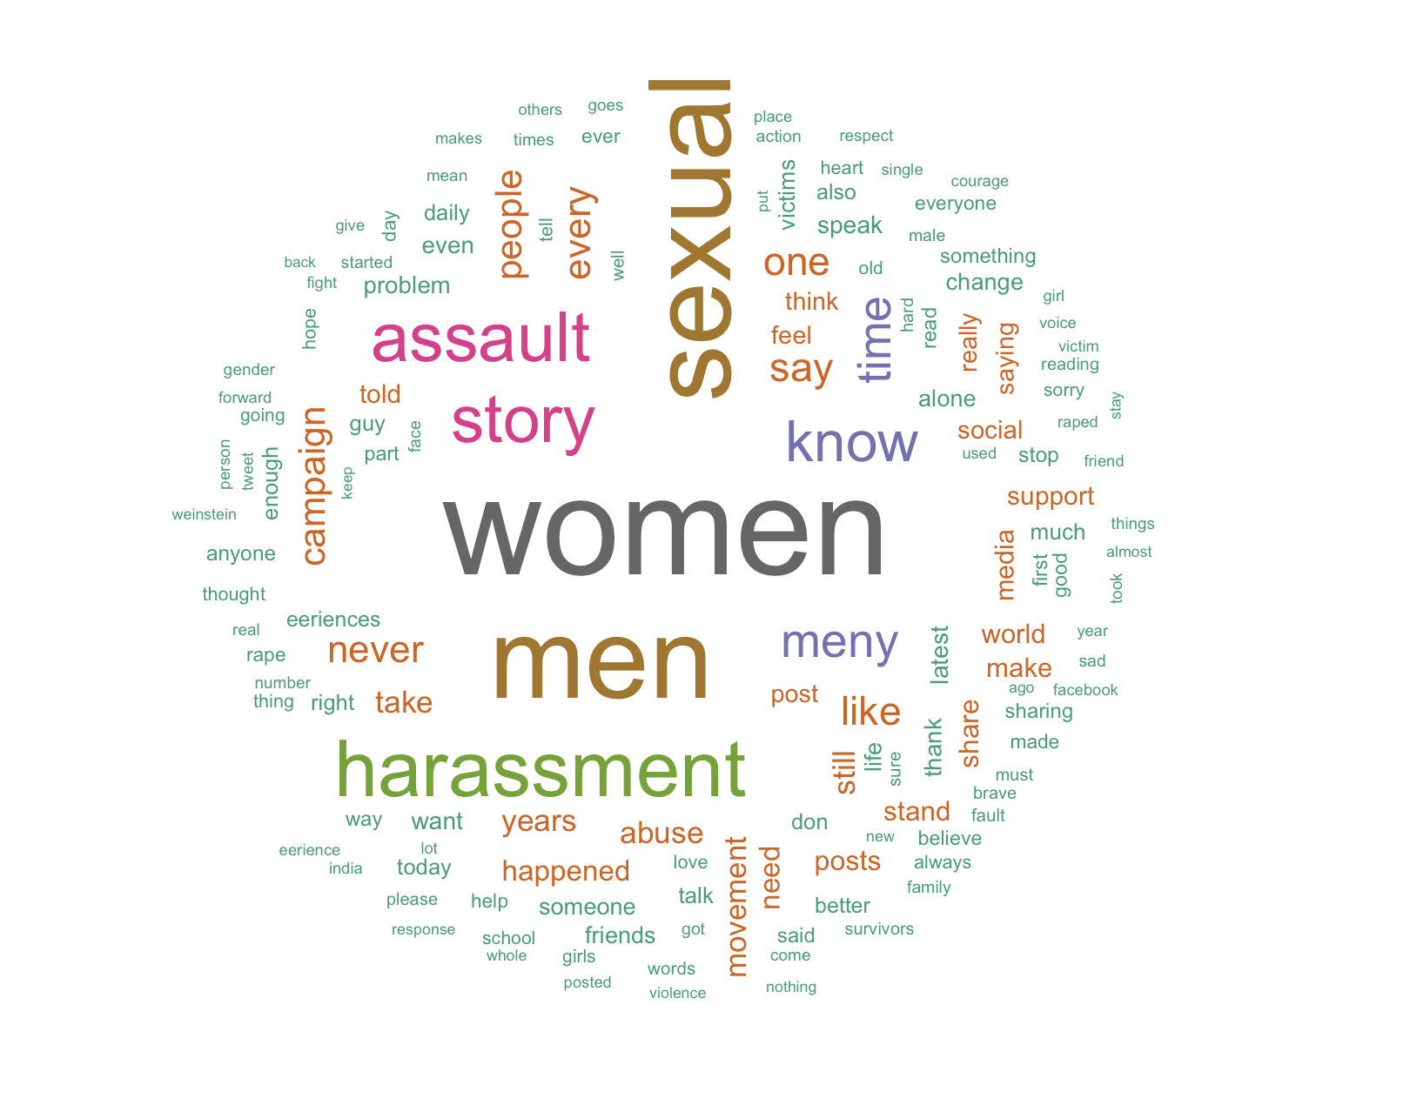

Slide 10
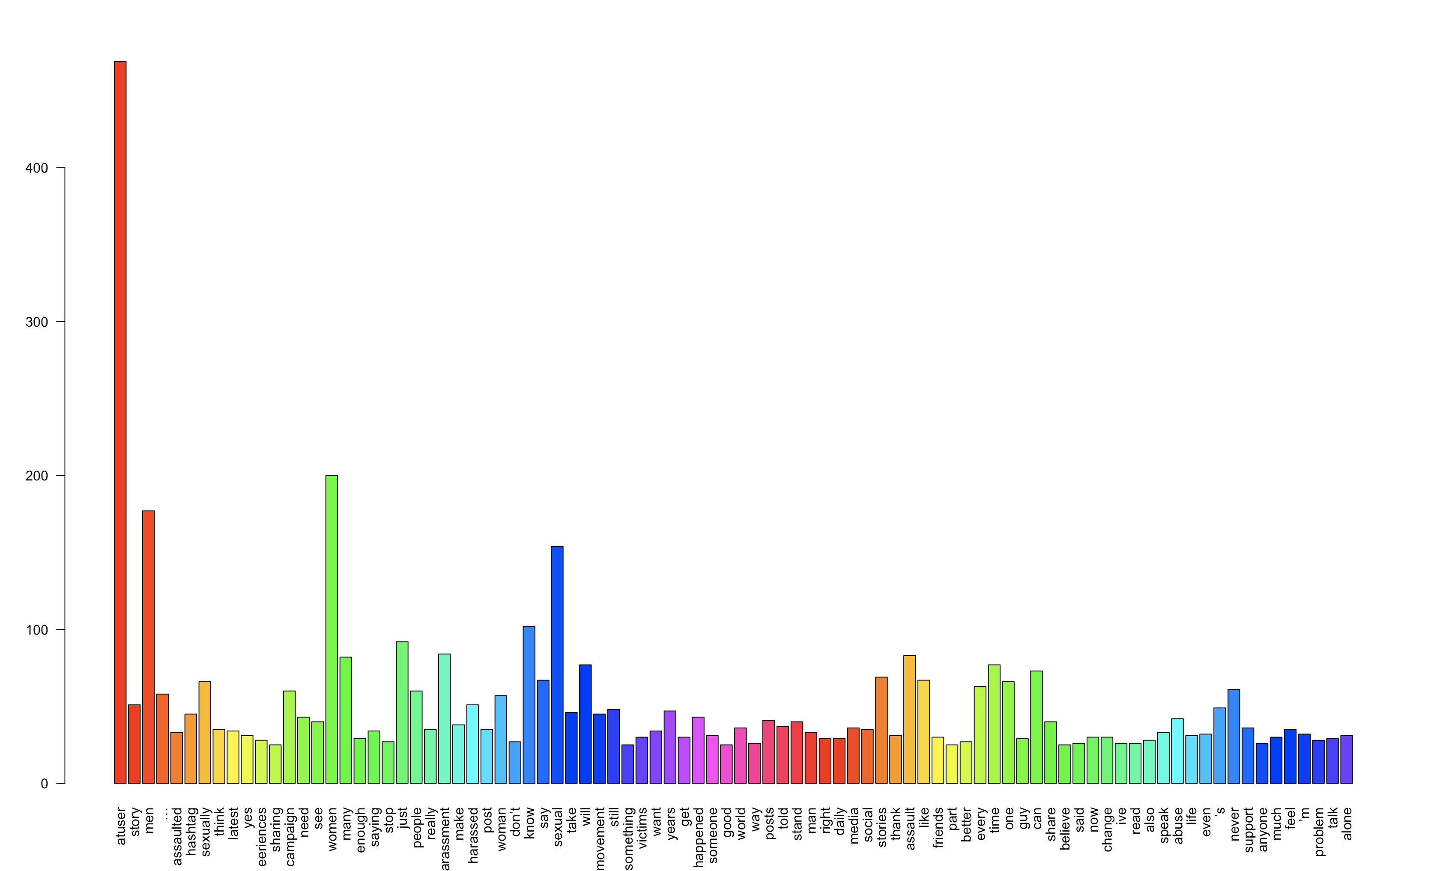

Slide 11
Corpus
Lower case
Special characters
Digits
Underscores
Punctuation
Stopwords
URLs
Replaced some words
Removed some words
Data Processing &
Cleaning Techniques

Slide 12
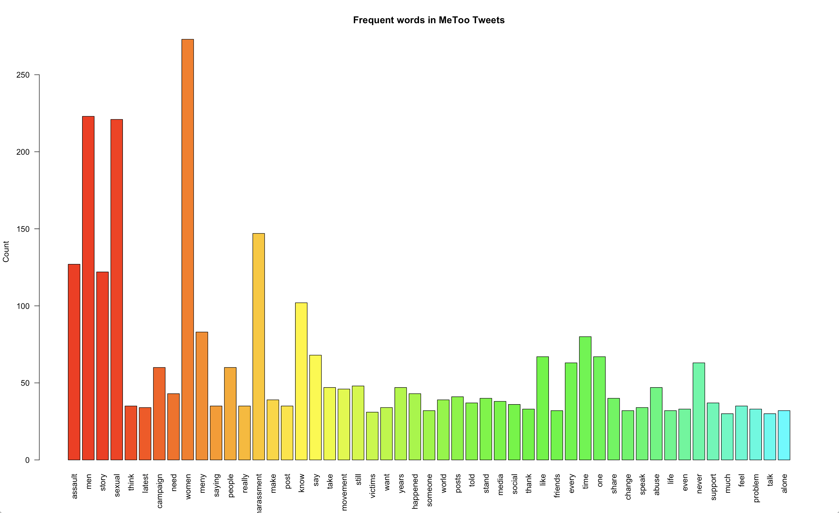

Slide 13
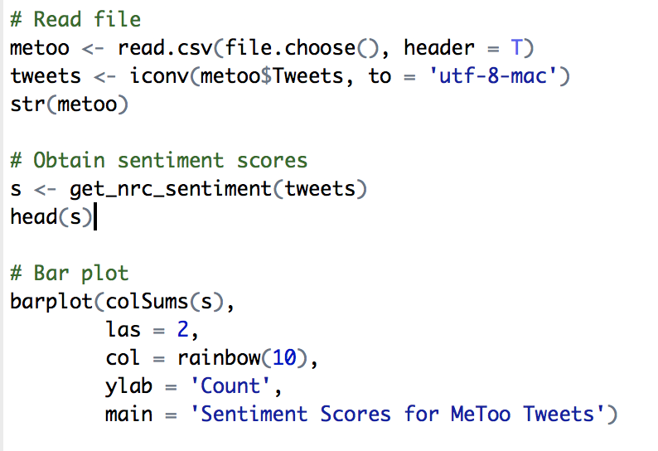
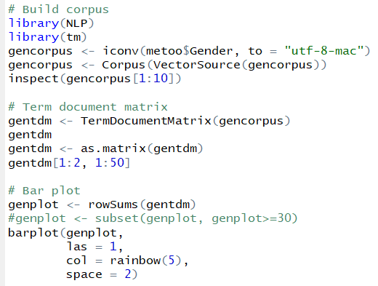
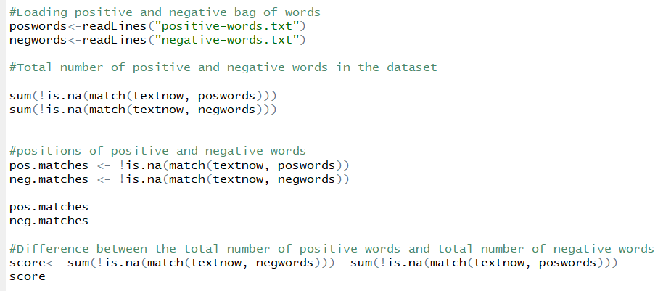

Slide 14
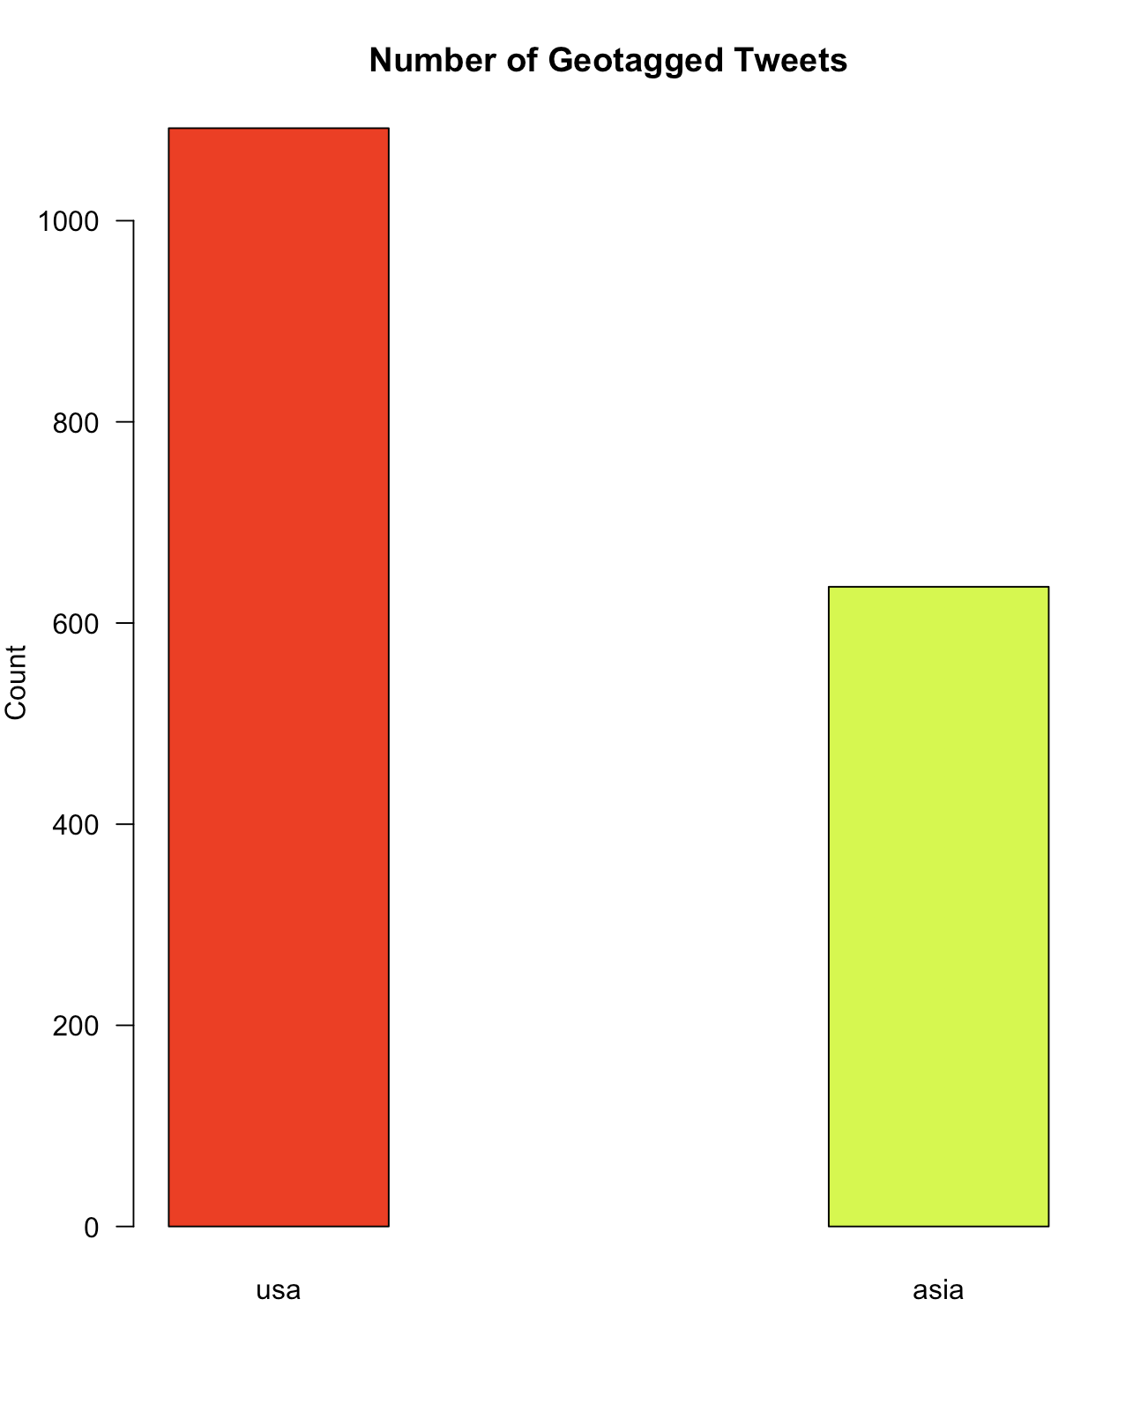
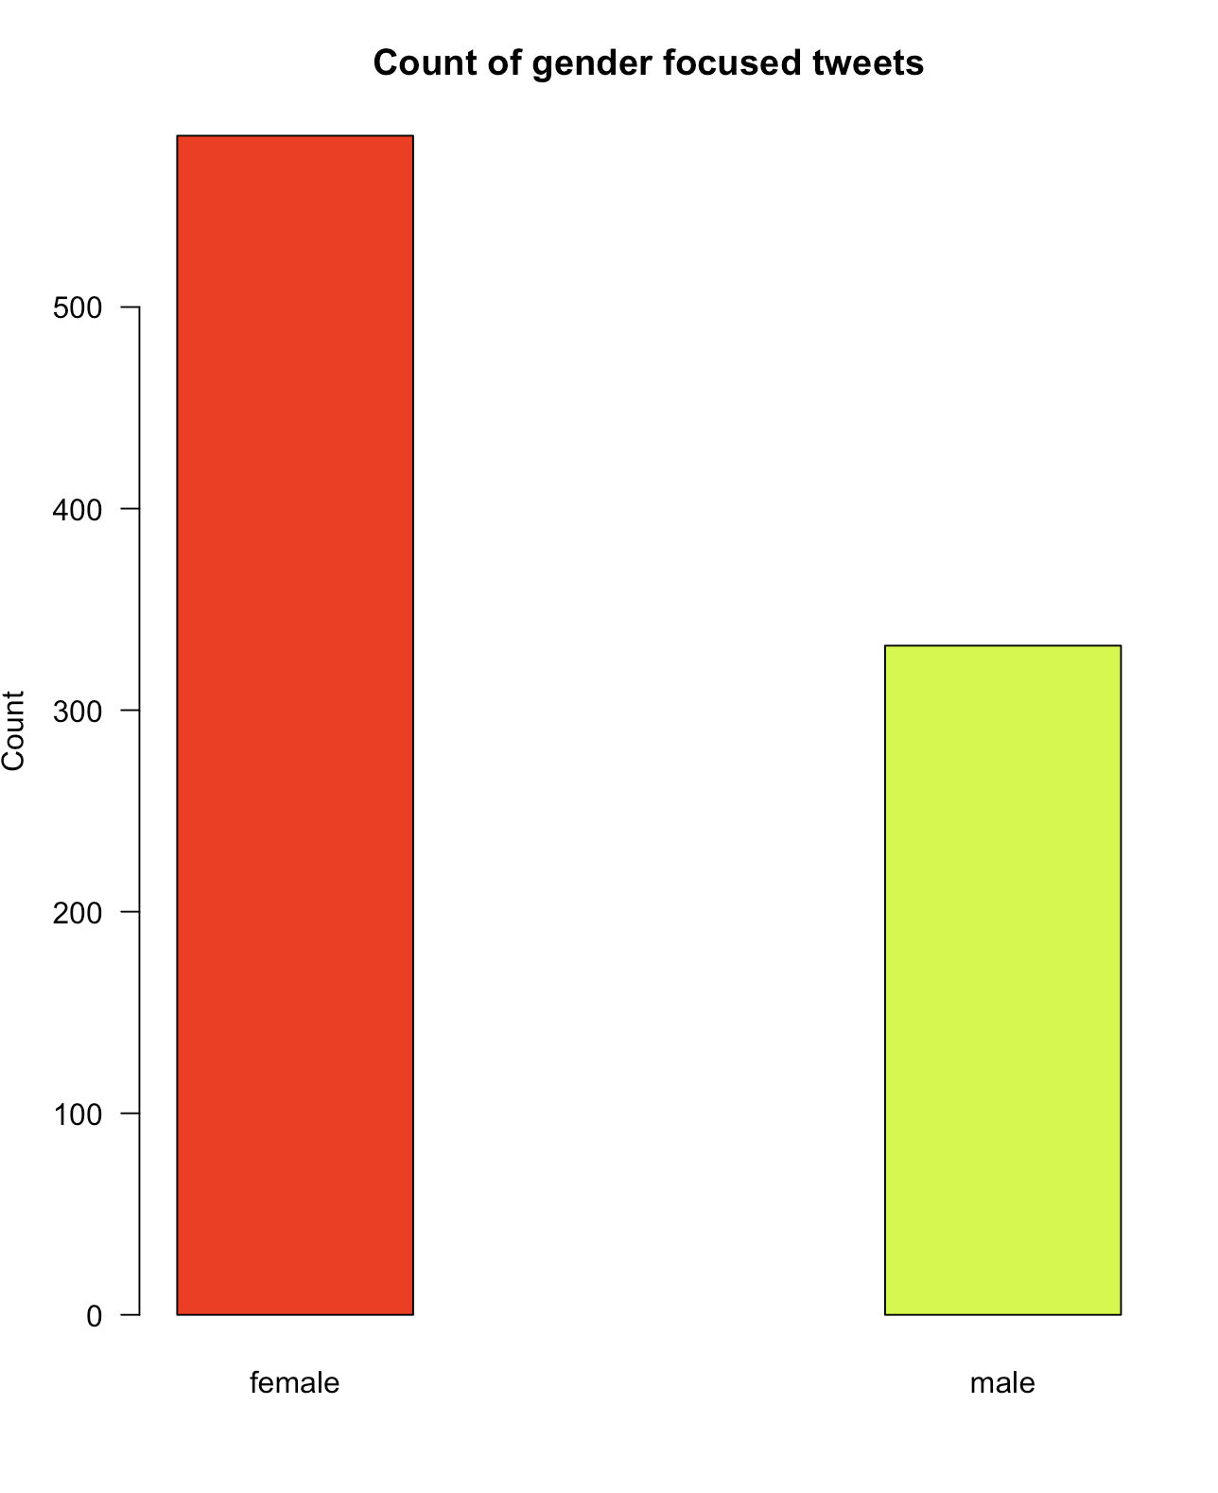

Slide 15
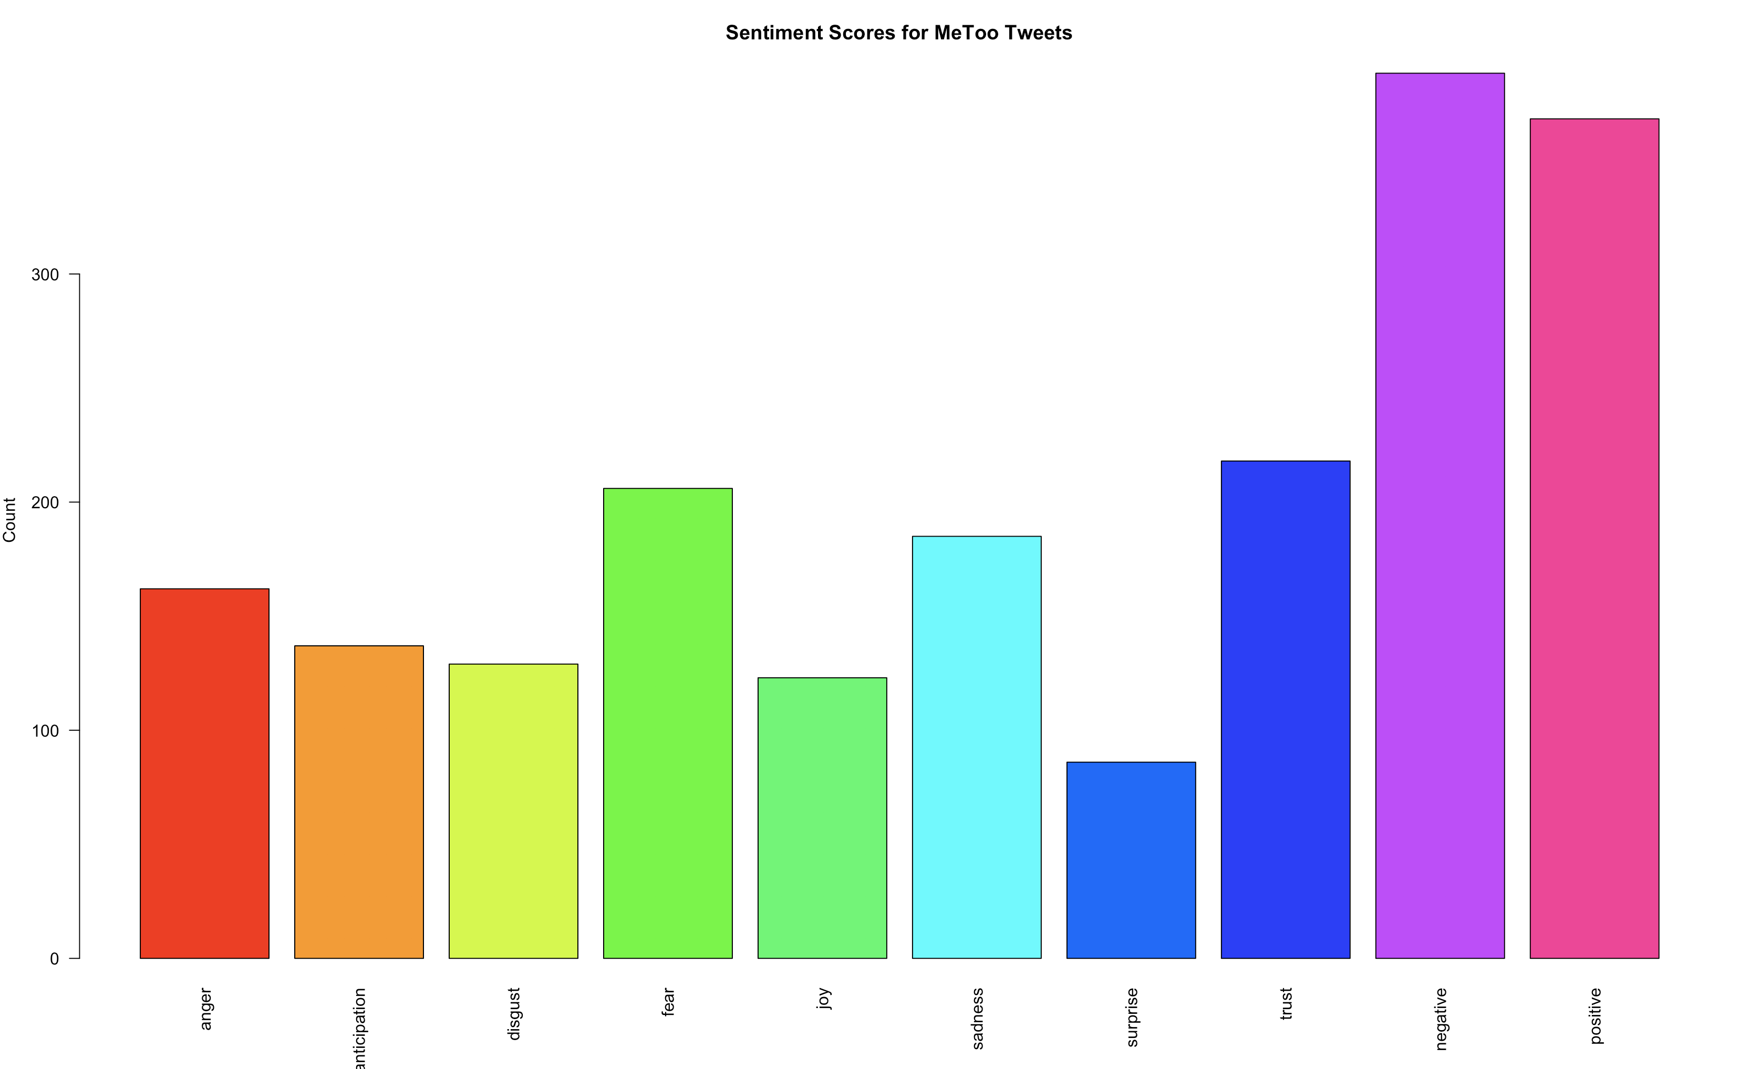

Slide 16
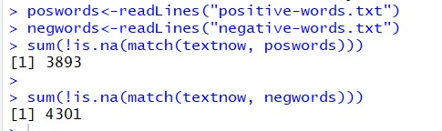
Summary
We achieved an overall sentiment score of 408 for the dataset.

